Slide 1
JOKE BOT MODEL &FINE-TUNE MODEL
Turkish Joke Generator using LLMs

Slide 2
Project Details
University
Maltepe University
Course
SE 403 01 Software Project Management
Supervisor
Ensar Gül
TEAM 9

Slide 3
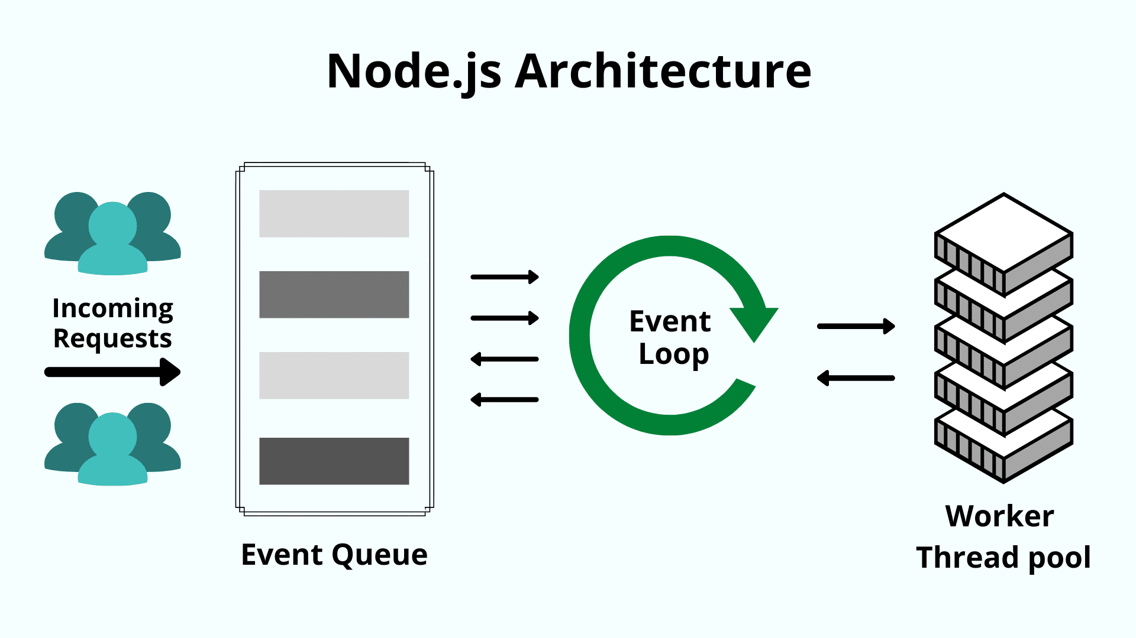
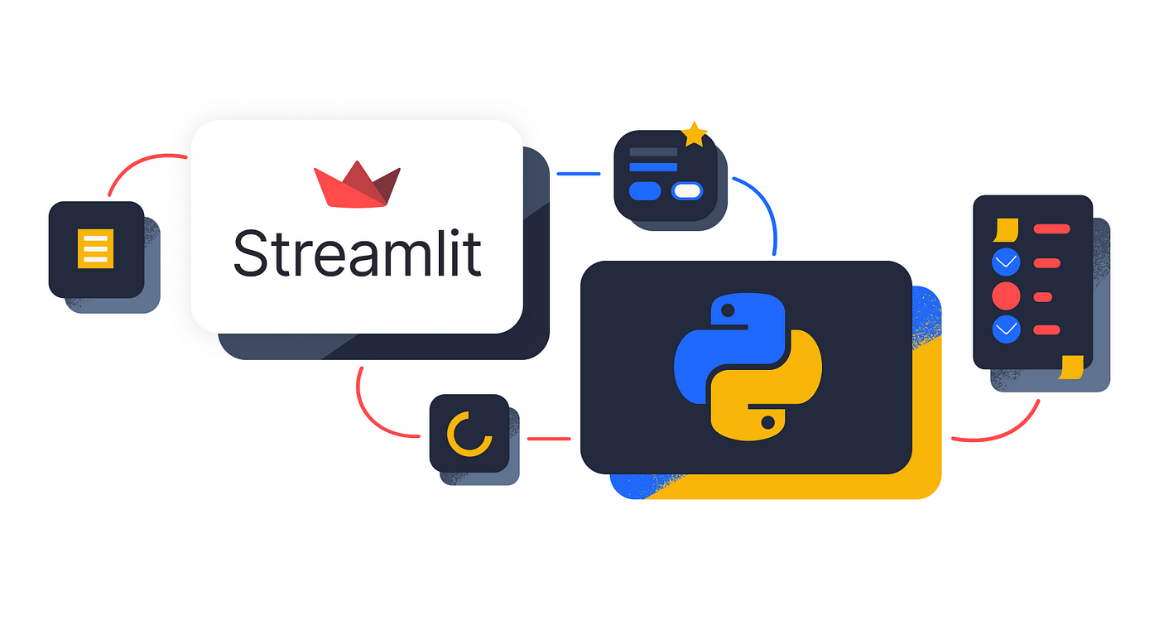
Project Overview
Both models were connected to real-time user interfaces—Node.js + EJS for the custom model and Streamlit for the GPT-2 model—to ensure accessibility and interactivity.
From a project management perspective, we followed an Agile-based development cycle, using Trello for sprint planning and GitHub for version control and collaboration.
The goal of this project is to generate Turkish jokes using large language models (LLMs), with a special focus on culturally appropriate and humorous outputs.
We developed two different models:
A custom Transformer model, trained from scratch using PyTorch and a manually curated dataset of general Turkish jokes.
A fine-tuned GPT-2 model, adapted from a pre-trained Turkish language model (ytu-ce-cosmos/turkish-gpt2) and specialized in Nasreddin Hoca jokes.

Slide 4
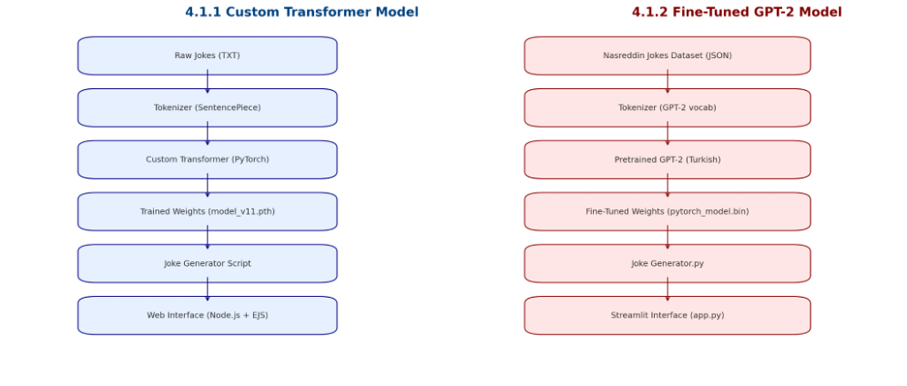
Project Overview
The fine-tuned model demonstrated the efficiency of transfer learning, enabling faster convergence and higher fluency with domain-specific data.
The custom model allowed us to explore the inner workings of LLMs, including architecture design, training dynamics, and token-level predictions.

Slide 5
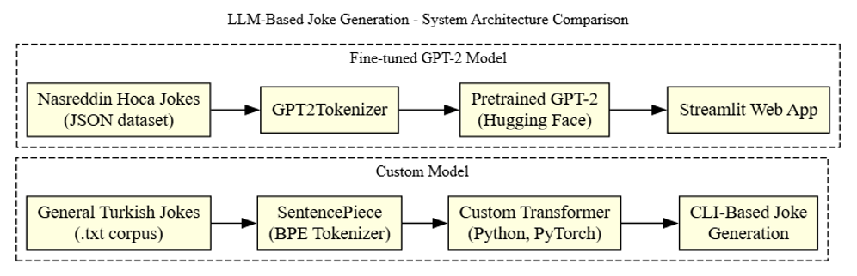

Slide 6
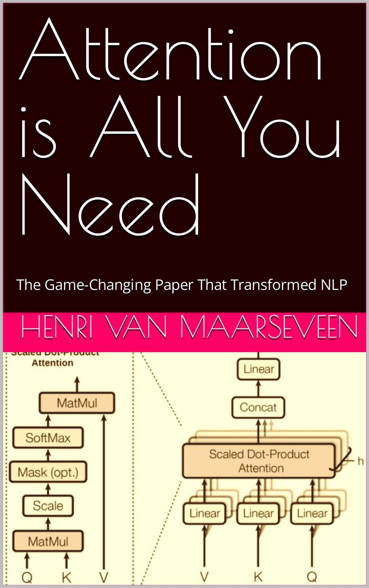
Transformer Theory - Inspired by: “Attention is All You Need”
This project is grounded in the Transformer architecture, the foundation of today’s large language models (LLMs).
Our custom model design was heavily influenced by the paper “Attention is All You Need” (Vaswani et al., 2017).
Introduced the concept of self-attention, allowing models to understand relationships between words regardless of position.
We applied these principles in our model’s multi-head attention, positional encoding, and training loop.
The paper helped us understand how context is built and how transformers outperform RNNs in sequence tasks.

Slide 7
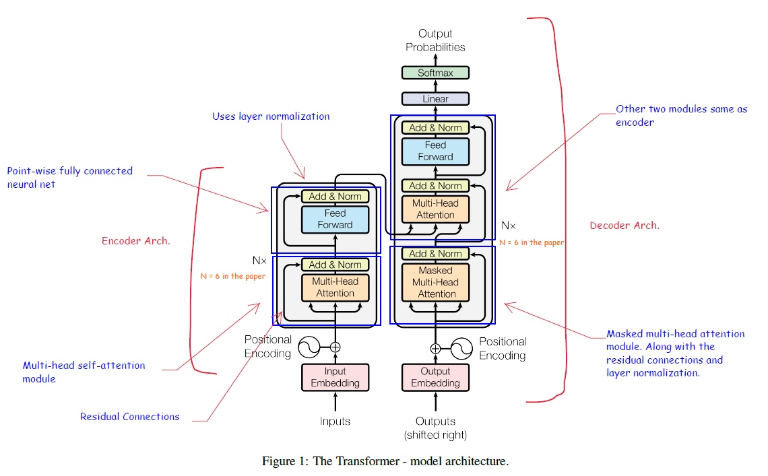

Slide 8
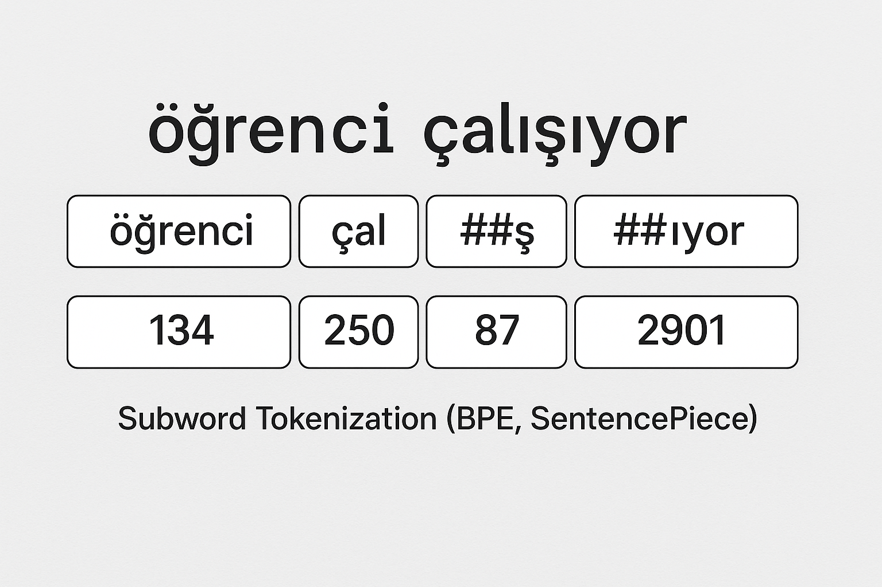
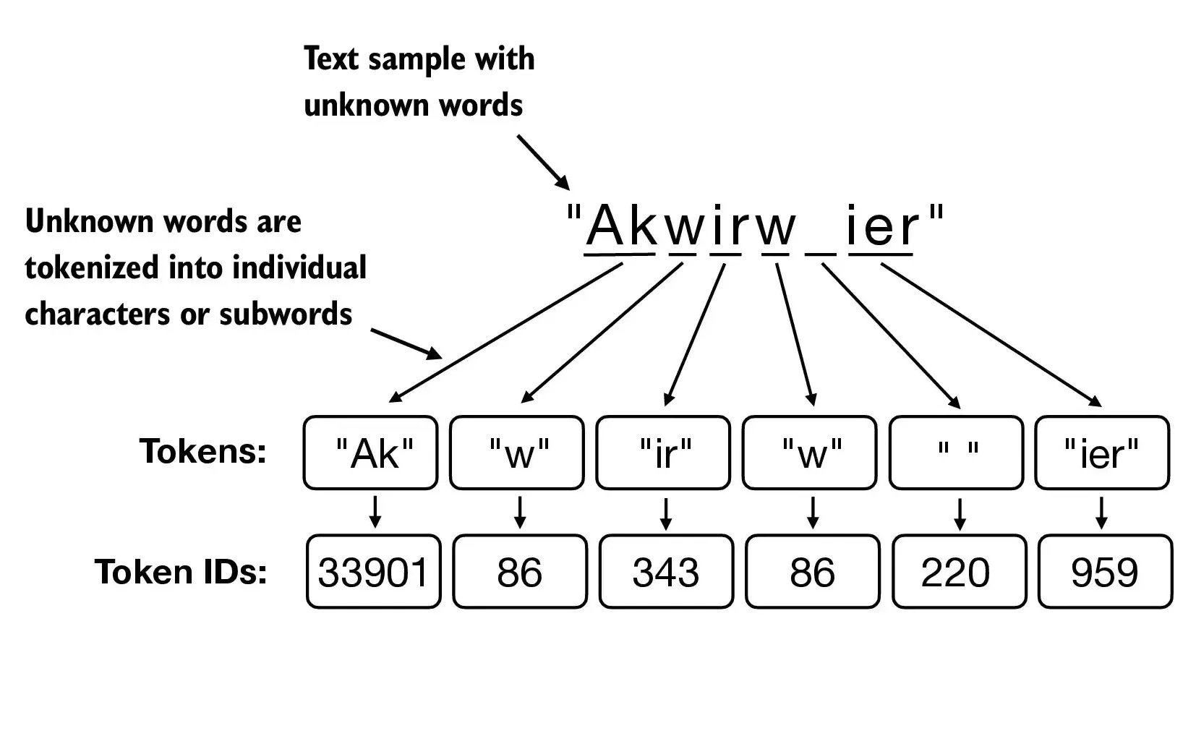
Data & Tokenization
Custom Transformer Model
Trained using a plain .txt file containing general Turkish jokes.
A custom tokenizer was created using SentencePiece.
Tokenization method: Byte Pair Encoding (BPE), effective for breaking Turkish words into subword units.
Vocabulary size was set to 5000 tokens, optimized for a small dataset.
The tokenizer was saved as .model and .vocab files, and reused during inference to ensure consistency.
Here is the subword tokenization visual you requested, showing how Turkish words are split and converted into token IDs using SentencePiece.

Slide 9
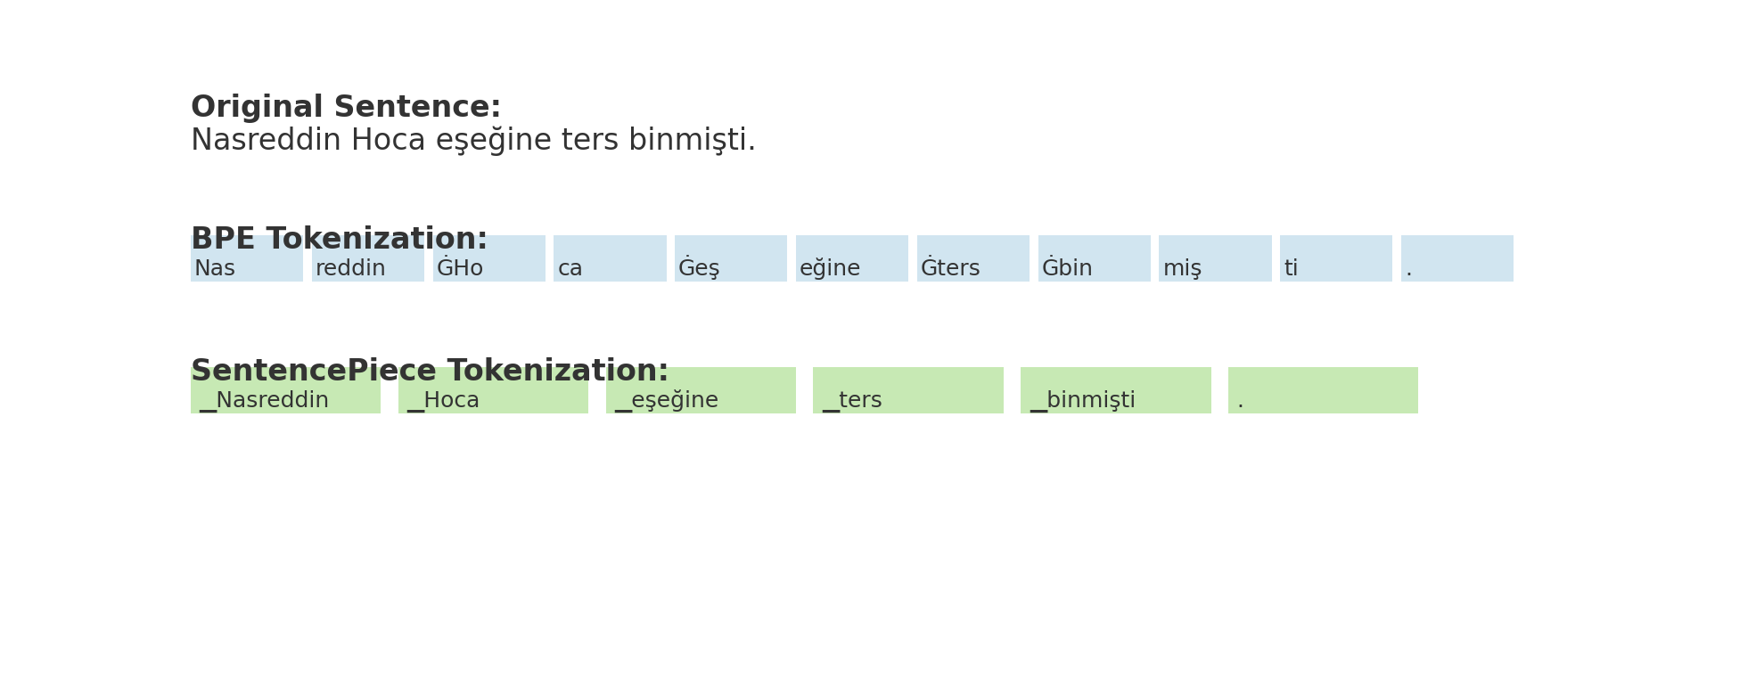
Data & Tokenization
Custom Transformer Model
The sample of the tokenization from our custom model:

Slide 10
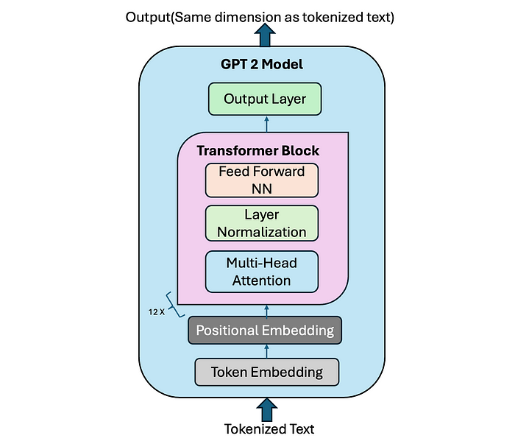
Data & Tokenization
Fine-tuned GPT-2 Model
Trained on a structured JSON file of Nasreddin Hoca jokes.
Used the pre-trained GPT-2 tokenizer from Hugging Face (ytu-ce-cosmos/turkish-gpt2).
This tokenizer already supports Turkish, using a pre-built BPE vocabulary.
Full compatibility with GPT-2’s architecture made fine-tuning faster and easier.

Slide 11
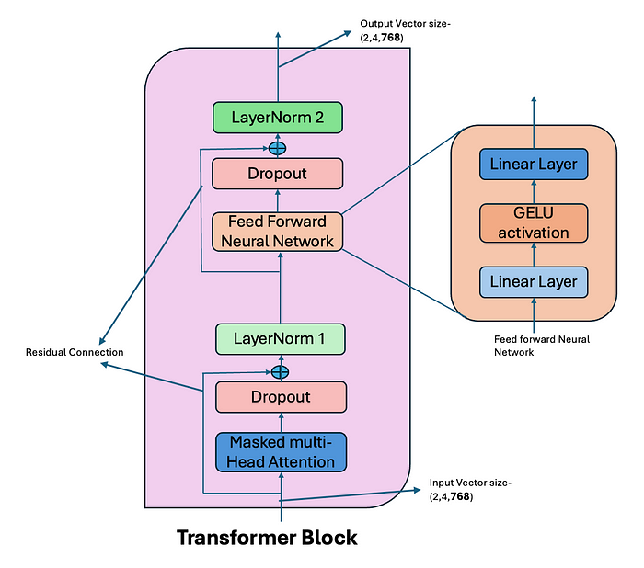
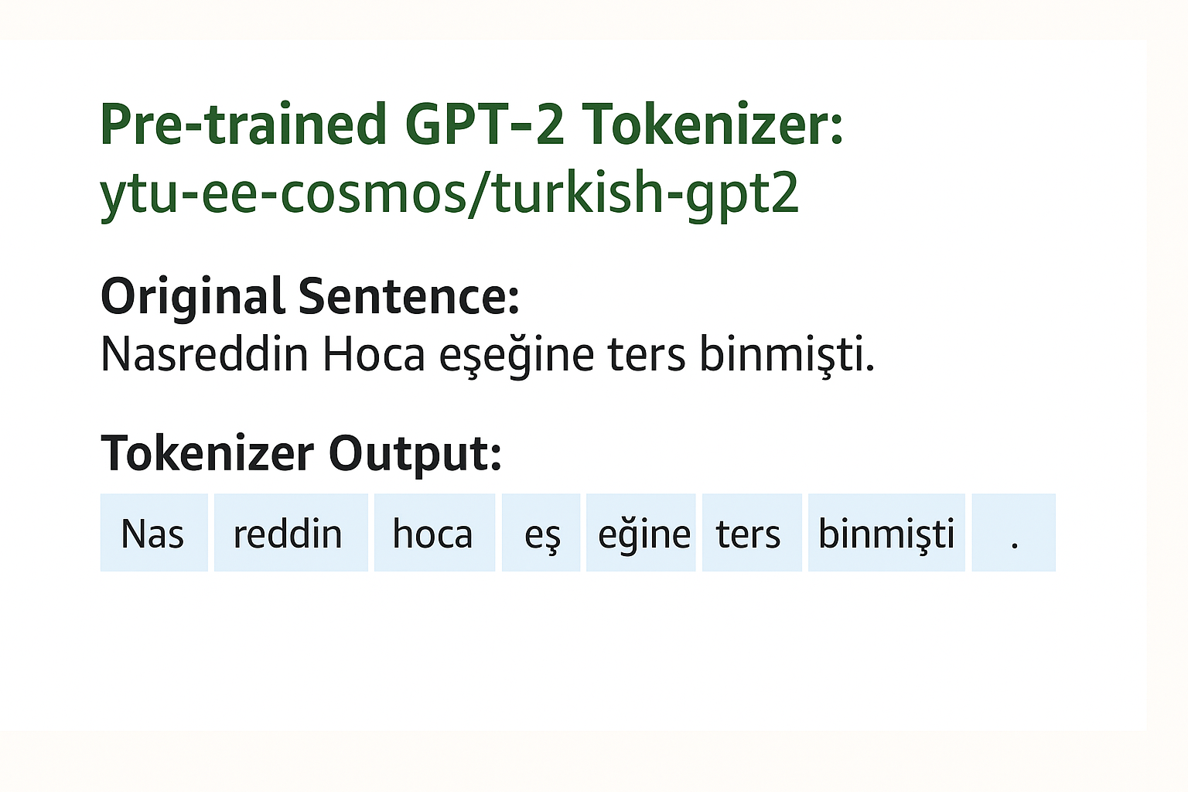
Data & Tokenization

Slide 12
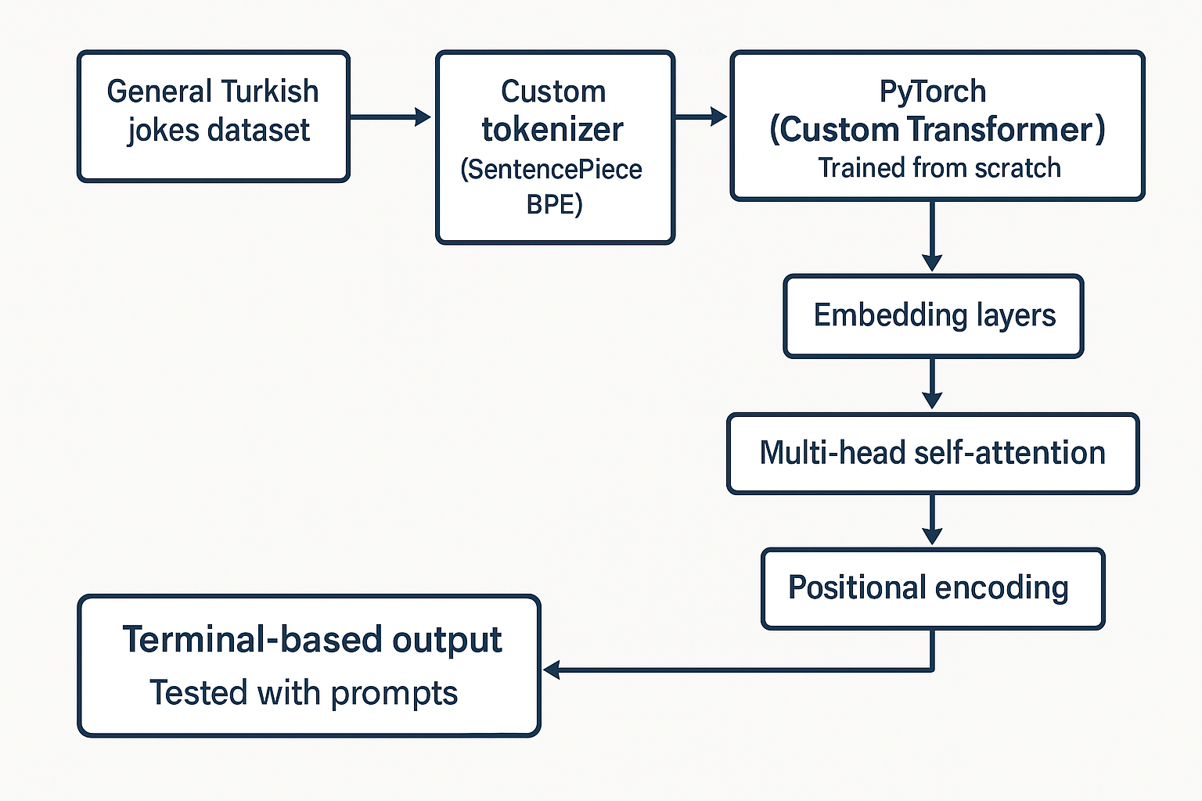
Custom Transformer Model
We developed a small Transformer-based language model using PyTorch.
The model was trained from scratch on a dataset of general Turkish jokes to better understand how LLMs work at a low level.
We created a custom tokenizer using SentencePiece with the Byte Pair Encoding (BPE) method, which helped split Turkish words into meaningful subword units.
The architecture includes:
Embedding layers for word representation
Multi-head self-attention for capturing word relationships
Positional encoding to keep track of word order

Slide 13
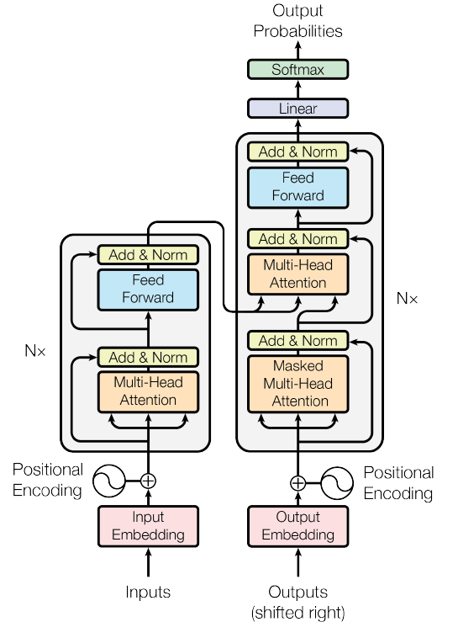
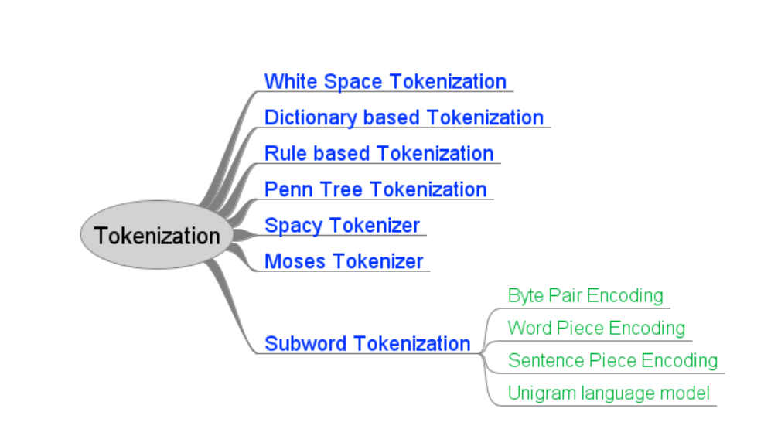
Custom Transformer Model
The training process was done inside a Jupyter Notebook, and loss values were tracked to monitor progress.
The final outputs were generated through a command-line interface, where users could enter prompts and receive joke responses.
This model helped us learn the internal components of LLMs and provided a baseline to compare with the fine-tuned GPT-2 model.

Slide 14
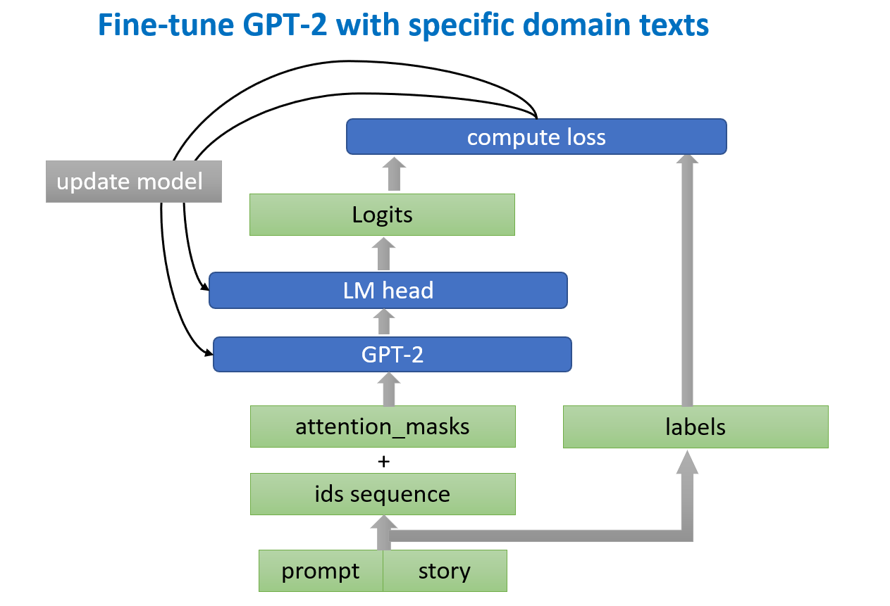
Fine-tuned GPT-2 Model
This model was built by fine-tuning a pre-trained Turkish GPT-2 model from Hugging Face: ytu-ce-cosmos/turkish-gpt2
It was fine-tuned using a cleaned dataset of Nasreddin Hoca jokes, focusing on capturing his unique storytelling style and humor.
The goal was to specialize the model in generating jokes that are culturally relevant, coherent, and funny.
We used the Hugging Face Transformers library for training and inference, which made the process easier and modular.

Slide 15
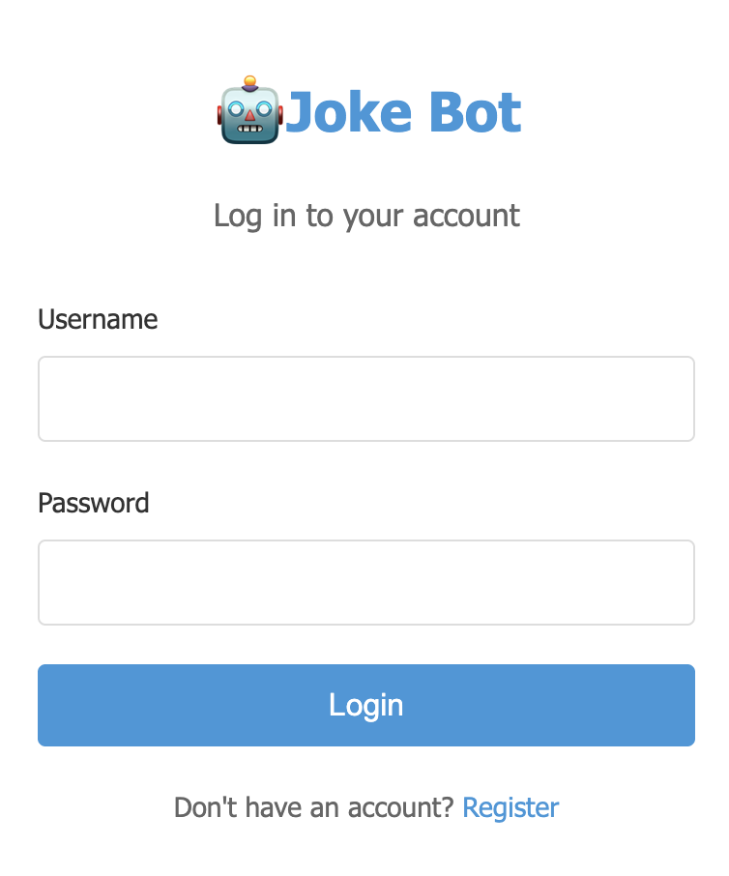
User Interfaces
Custom Transformer Interface
Developed using Node.js, Express, and EJS (template engine).
Users can log in, register, and submit a prompt to generate a joke.
The backend connects to the PyTorch model running separately as a service.
Sessions and routing are managed using Express and JWT-based authentication.
Frontend pages include:
Login, Register, and a Joke Generator form.
Ideal for structured multi-page interaction and user-based testing.

Slide 16
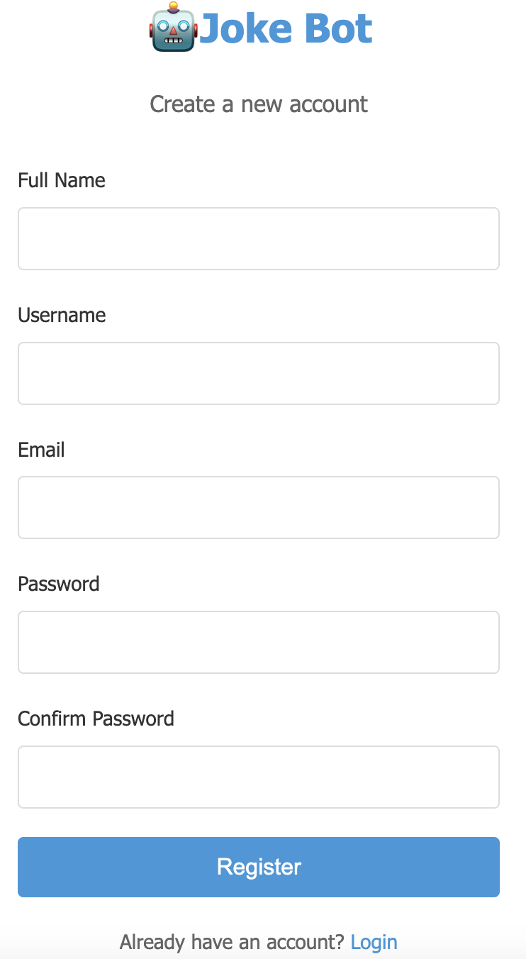
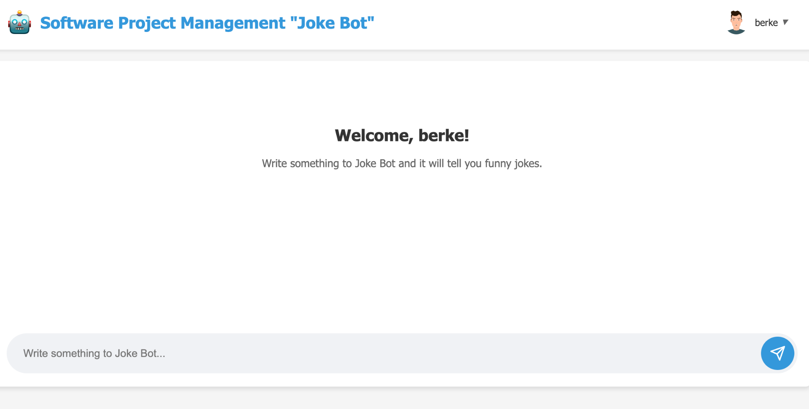
Custom Model Frontend

Slide 17
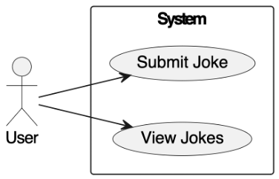
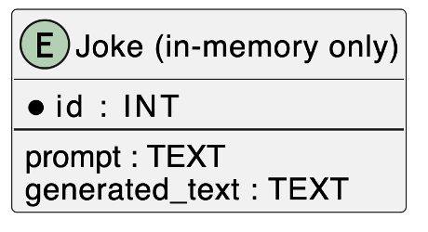
ER & Use Case Diagrams

Slide 18
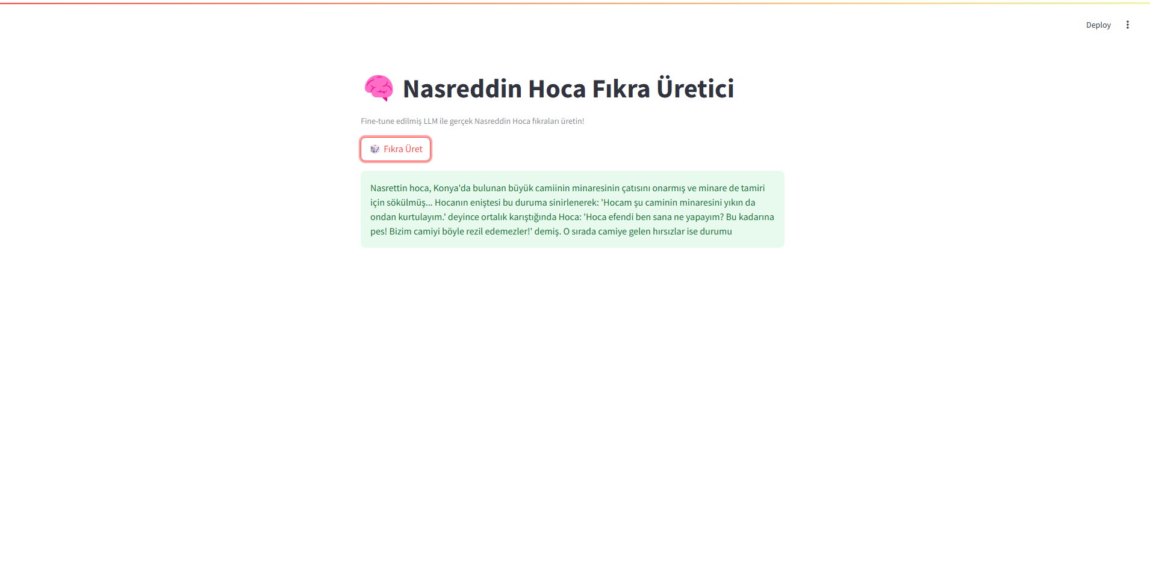
User Interfaces
Fine-tuned GPT-2 Interface
Built using Streamlit, a Python-based UI framework.
Includes a single-button interface for generating jokes instantly.
Uses Hugging Face’s pipeline API to run the model efficiently.
Users can tweak generation settings like:
temperature, top_k, top_p, and max_length.
Fast to deploy, minimal setup, and great for live demos or testing sessions.
The final model was integrated into a Streamlit interface, allowing users to generate jokes with a single click.
Fine -Tune Model Frontend

Slide 19
Testing & Evaluation
Test Type | Description | Tools / Methods Used
Unit Testing | Ensured functions like tokenization, model loading, and response generation worked independently. | pytest, manual run assertions
Output Consistency Check | Same prompt was tested multiple times to check deterministic or diverse output. | Logging and sampling monitoring
Syntactic Validity Test | Ensured the joke generated formed complete sentences in Turkish. | Turkish grammar validation, manual review
Semantic Coherence Test | Verified if the jokes made logical and humorous sense. | Manual rating by team members
Performance Testing | Measured model loading speed and response time in both Streamlit and Node.js UIs. | Python time module, browser dev tools
Token Overlap Ratio | Used to see how novel the generated jokes were (repetition from training set). | Custom script comparing tokens

Slide 20
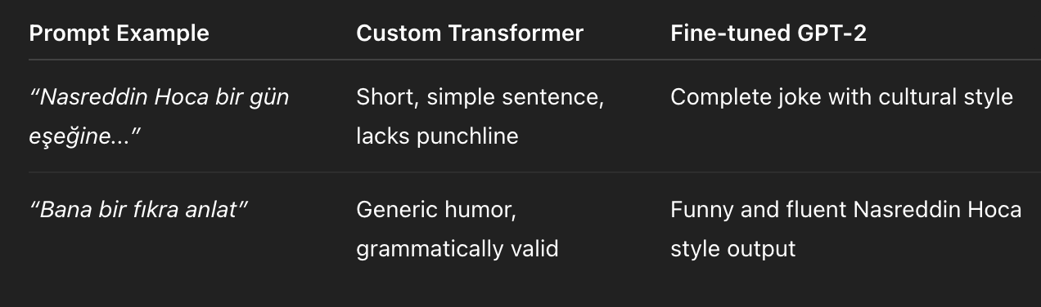
Testing & Evaluation

Slide 21
Model Output Comparison
Test Case ID | Model Type | Input Prompt | Expected Output | Actual Output Example | Pass/Fail | Notes
TC-001 | Custom Model | Bana bir fıkra anlat | Türkçe, kısa, anlaşılır ve komik bir genel fıkra üretmeli | “Adam karısı doktora götürmüş. Doktor ‘Ne şikayetiniz var?’ demiş. Kadın: ‘Bu adam çok susuyor.’” | ✅ Pass | Beklenen genel espri yapısına uygun, akıcı çıktı
TC-002 | Fine-tuned Model | Bana bir fıkra anlat | Nasreddin Hoca üslubunda, esprili ve kültürel içerikli fıkra | “Nasreddin Hoca bir gün pazarda eşeğini kaybetmiş. ‘Kim gören var mı?’ demiş. Adam: ‘Ne eşeği hoca?’…” | ✅ pass but not complete | Hedeflenen Hoca mizah üslubunu yansıtan anlamlı ve tutarlı çıktı üretildi fakat cümle bitmiyor.

Slide 22
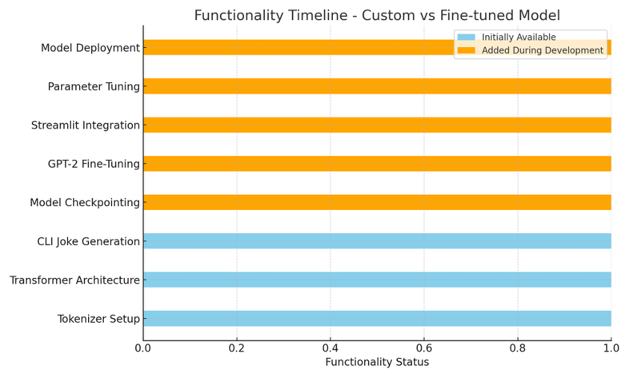

Slide 23
Deployment
Custom Transformer Model Backend: Python script with PyTorch (model loaded for inference) Frontend: Node.js + Express + EJS Database: MongoDB used for storing user data | Requirements: Node.js ≥ 16.x Python ≥ 3.8 MongoDB ≥ 5.0 SentencePiece tokenizer files: .model, .vocab | Deployment Steps: Start MongoDB server Launch backend model script (PyTorch) Run frontend with: node app.js Accessible at: http://localhost:3001/login or jokebot.online/dashboard
Fine-tuned GPT-2 Model
Deployed using Streamlit, a lightweight Python UI library
Integrated with Hugging Face’s generation pipeline
Requirements:
Python ≥ 3.8
Libraries: transformers, torch, streamlit, sentencepiece
Deployment Steps:
Run app with: streamlit run app.py
Pretrained weights (.bin file) are hosted externally (Google Drive)
No need for separate frontend/backend layers

Slide 24
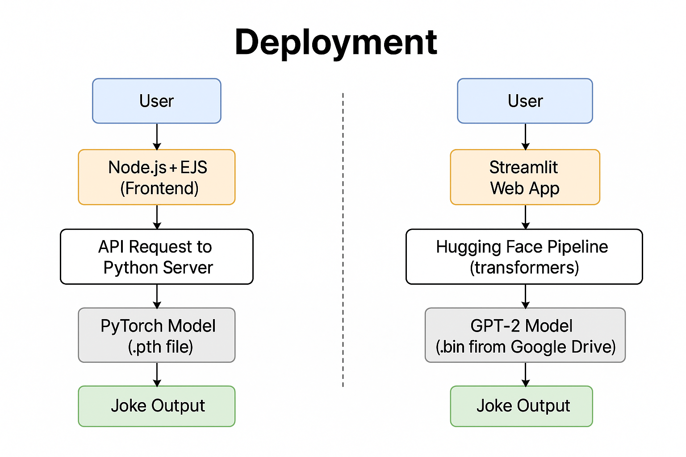

Slide 25
Risk Management
Technical Risks:
Dataset Problems: Incomplete/malformed joke entries fixed via a Python cleaning script.
Model Compatibility: LLaMA was abandoned due to Colab GPU limits → switched to GPT-2 (ytu-ce-cosmos).
Training Interruptions: Used checkpoints every 200 steps to prevent data loss from Colab timeouts.
Tokenization Risks: SentencePiece token set was capped at 8000 to avoid sparsity and instability.
Team & Workflow Risks:
Asynchronous Environments: Solved via shared requirements.txt and setup scripts.
Git Merge Conflicts: Mitigated by enforced commit naming and GitHub issue tracking.
Coordination Challenges: Used Trello + weekly retrospectives to unblock tasks.

Slide 26
Project Management Tools
Trello – Task Management Used for weekly task assignments and sprint tracking Organized tasks by categories: model, UI, data, testing Visualized progress through iteration-based boards Helped identify blockers and delays early | GitHub – Version Control Enabled collaborative coding and safe updates Used branches and pull requests to manage changes Commit messages were standardized (e.g., "frontend fix", "fine-tune update") Helped us resolve merge conflicts efficiently | Team Communication Held weekly Google Meet retrospectives for sprint evaluation Used WhatsApp for daily communication and quick decisions Shared Google Docs for collaborative report writing and reflection sections

Slide 27
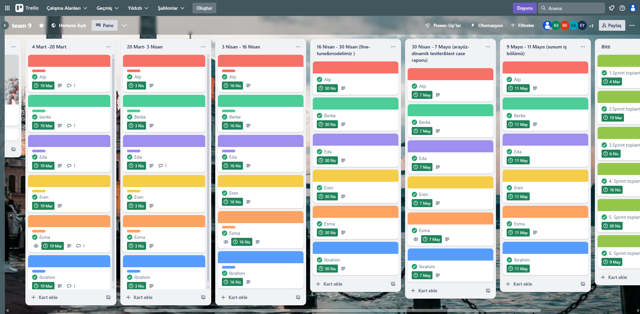

Slide 28
Sprint Breakdown & Tasks
Sprint 1: Model architecture discussions, Dataset search and cleaning, Exploring Hugging Face and PyTorch tools
Sprint 2: SentencePiece tokenizer training, Comparison with prebuilt tokenizers, Dataset labeling (e.g., Nasreddin vs. Karadeniz)CUDA setup and GPU research
Sprint 3: Custom Transformer training with PyTorch, Training loop and loss tracking, Testing early outputs, LLaMA + Quantization technique exploration
Sprint 4: Switched to GPT-2 (ytu-ce-cosmos) Fine-tuning on Nasreddin dataset, Streamlit UI development, Model parameter tuning (temp, top-k)
Sprint 5: UI building (Node.js + Streamlit) Output evaluation (fluency, humor) Sampling joke generations, Model selection for deployment
Sprint 6: Report and presentation workFinal bug fixes and testingTask delegation for deliverablesRepo and asset cleanup

Slide 29
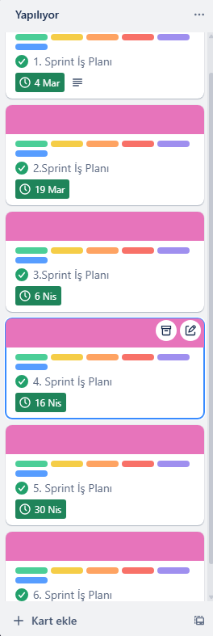
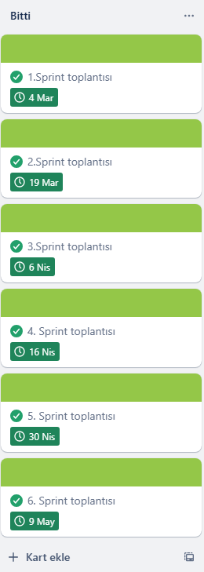
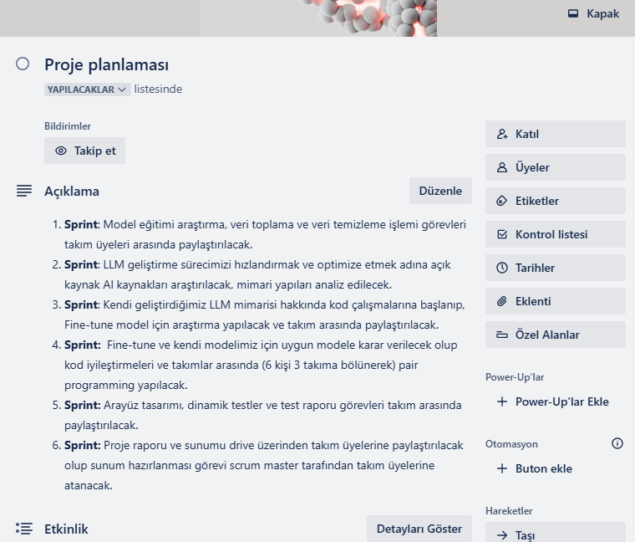
Sprint Breakdown & Tasks

Slide 30
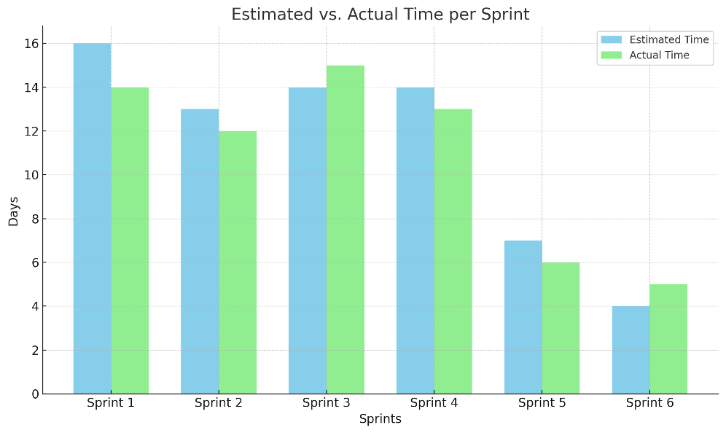

Slide 31
THE END
THANK YOU FOR LISTENING
NOW, DEMO TIME!

